Slide 1



KACE: Kernel-Aware Colocation for Efficient GPU Sharing
ACM SoCC’24
Bing-Shiun Han, Tathagata Paul, Zhenhua Liu, Anshul Gandhi
Stony Brook University
Notes:
Hello everyone, I am bing han. Aphd student. From stony brook univsity. Today, I am happy to share our work KACE, which enables effficent GPU sharing with kernelaware colocation.

Slide 2

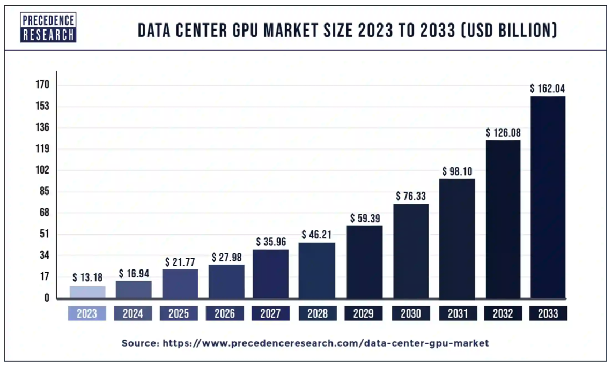


GPU as a Service is Booming
LLM
12.3x
AI
HPC
Notes:
GPU as been a hot topic. Thanks to the emergence of AI and HPC, GPU market projected to grow 12 times within 10 years, the role of GPUs has become even more central, making GPUaaS an increasingly vital factor in the coming years https://epochai.org/blog/trends-in-gpu-price-performance
Two slides –separately – first – GPU demands second – Dl workloads contributes GPU demands

Slide 3
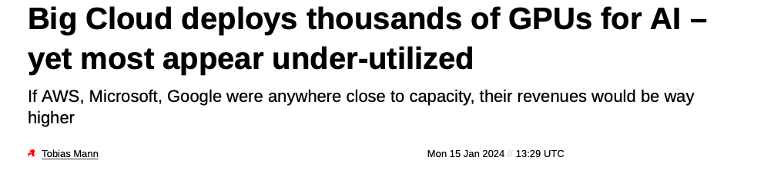
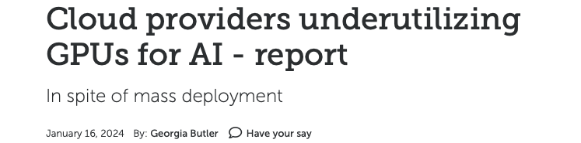
GPUs are underutilized in Datacenter
How to increase GPU utilization?
Sources: https://www.theregister.com/2024/01/15/cloud_providers_gpu_analysis/
Notes:
Ｄemand for GPU is booming thanks to the need for LLM and AI applications. Despite the increasing demands Cloud providers have failed to fullly utilize their GPUs. Therefore, how to increase GPU utilization has become an important issue first, DL jobs are diverse. lightweight jobs can not fully use powerful datacenter-grade GPUs Second, by nature, Cloud providers provision far more capacity than they expect to sell. This is beacuse they have to plan for peak demand during rush hours So that leads to our question – can we increase GPU utilization? 878,000 accelerators were responsible for turning out seven million GPU-hours of work, which the research outfit estimates adds up to roughly $5.8 billion in revenue spending. Source https://www.theregister.com/2024/01/15/cloud_providers_gpu_analysis/ https://www.theregister.com/2024/01/15/cloud_providers_gpu_analysis/ https://epochai.org/blog/trends-in-gpu-price-performance 1. GPU capacity increases 2x (Nvidia device)
Option 2. remove left part 3. change title to encapsulate both msg 4. why data center is underutilized? List enterprise if not complicated solutions https://www.linkedin.com/posts/haiyongw_the-1000-times-increase-in-nvidia-gpu-performance-activity-7110666027297869826-LIMv/#:~:text=10mo-,The%201000%20times%20increase%20in%20Nvidia%20GPU%20performance%20(FLOPs%20to,)%20and%20sparsity%20(2x).

Slide 4


Solution- Colocating workloads
Interference
100%
20%
80%
J2
J2
Colocation improves GPU utilization, decreases completion time, increases throughput
40%
J1
GPU Utilization
J1
Challenges?
Interference between colocated workload
Workload dependent
GPU share policy, architecture
Minimize interference via prediction
Requires per-workload metrics to predict precise colocated performance
Huge search space to profile all possible colocations
DL approach requires large training set and time
NO sharing
Shared
Total completion time
100s
J2
Interference
70s
Challenges in GPU interference for workload colocation:
1. Minimizing performance degradation
2. Metrics for predicting interference
3. Profiling overheads
J2
40s
J1
J2
J1
J1
Ideal sharing
NO sharing
Shared
Illustration graph. Not experimental data.
Notes:
Say data us exmaple not real exp da A common way to increase utilization is through colocating workload within a GPU. It also decrease completion time and increase throughput. Here’s an illustration graph for colocating two mockup jobs. These jobs are not experiment data. On the top graph, we see the utiliztion of running two jobs exclusively, without sharing gpus. After shared, it fully utilizes the gpu to 100%. However, it is capped by GPU‘s compute capacity, thus the actual utilization is smaller than sum of two jobs, which cause performance slowdown interference The second graph shows the completion time of each job. Without sharing, job1 and job2 need 40 and 60s seconds to respectively, so the total comletion time requried is 100 s. finish, since only one job can be executed at a time. When we share gpu,, ideally, the completion time is 60 seconds, which is job2’s finish time. However, due to interference , the actual fisnihing tim is70s since we can coexecute both jobs. causing interference. This brings us to the challenge of colocating workloads. Firstis the interference is workload dependent, due to different levels of compute intensity, and the hostGPU data movement ;. GPU’s architeture also affects intference level as well. So how do we reduce interference? Onedirect method is to predict the right colocated workload to achieve minimum interference,
the utilization cap cause performance to be downgraded More improtaantly, interference during sharings, which extends。Completion time and reduce throughput ending

Slide 5


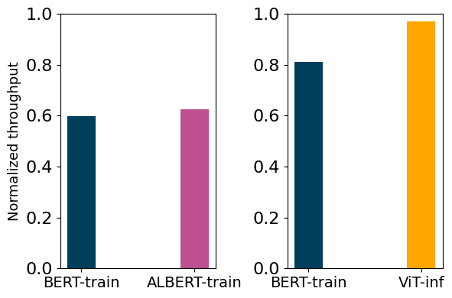
Challenge #1- Interference between colocated workloads
Performance interference is workload-dependent
Training or inference
Compute intensity per model
Data movement between host and GPU
System-level interference factors
GPU sharing policies
hardware architectures
19%
2%
40%
38%
Could we predict interference for a better colocation pair?
Notes:
Lets look into interference more. First, It is highly depending on the colocated workload due to different Resource requirements. . Also system we have did a simple colocation experiement on common DL workloads . First, we colocate two training workloads and compare its throughput with the workload running exclusively on GPU. We see that bert-train has a 40% slowdown similar to ALBERT-train. However, if we colocate bert with another inference workload, the slowdown is reducede to 19%, and inference only drop by 2%. Therefore, we should select inference workload to colocate with bert-train. Based on the observation, we see that fining best colocation pair does reduce interference and increase performance. Therefore, we come up the questions: could we predict interference for a better colocation pair? Explain each graph in detail. 40% compared with running by itself. Make itanimation show second graph later check the one on the right as ”why predict is better? It allows us to choose the collocated pair with good performance ”
When we colocated a BERT [5] training workload with an ALBERT [17] training workload, they experienced a throughput drop, relative to an exclusive run, of 40% and 37%, respectively. When the same BERT workload was colocated with a ViT [6] inference workload, the corresponding throughput drops were 19% and 3%, respectively. The much lower drop in throughput in the latter case was because the colocated Vit workload was an inference workload, and so did not require high GPU compute resources (e.g., for backpropagation). While the colocated ALBERT workload in the former case has much fewer parameters, and thus a lower memory requirement, it is a Transformer-based model, which requires significant GPU compute resources for training. Data movement - batched

Slide 6
Challenge #2- Predicting interference
Coarse-grained, overall resource usage pattern are not sufficient for prediction
Requires at least workload-level metrics to obtain precise colocated performance
Workload-specific metrics are not generalizable
Profiling workload metrics have overheads
Huge search space to profile all possible colocations
Large training set for ML-based approach
Long training time for ML models
Challenges in GPU interference for workload colocation:
1. Minimizing performance degradation
2. Discovering metrics for predicting interference
3. Profiling overheads
Notes:
Predicing interferenec has its challenge. first, the resource usage pattern need to be obtained within workload level to obtain precise predictions. HOwever, if we obtain the metrics specific to workload semantics and aceess patterns, the solution can not nbe generalized to all workloads. In addition, profiling workload metrics have overhead. It requries huge serach space if we profile all possible colocation combinations, and it reuqires large training set and time to predict with ml models. From here, we could sum up the challenges we face: 1. Overall usage of GPU and memory workload syntax

Slide 7
Problem Statement
How to choose colocated DL workloads to improve GPU utilization while minimizing performance interference with low profiling overhead?
Our solution
KACE - Kernel-Aware Colocation for Efficient GPU spatial sharing
Propose a lightweight, prediction-based approach to effectively colocate GPU workloads
Use exclusive kernel metrics collected offline to eliminate expensive online profiling
GPU workloads can share concurrently
Notes:
with low profiling overhead
Spatial sharing / temporal sharing
Spatial sharing

Slide 8
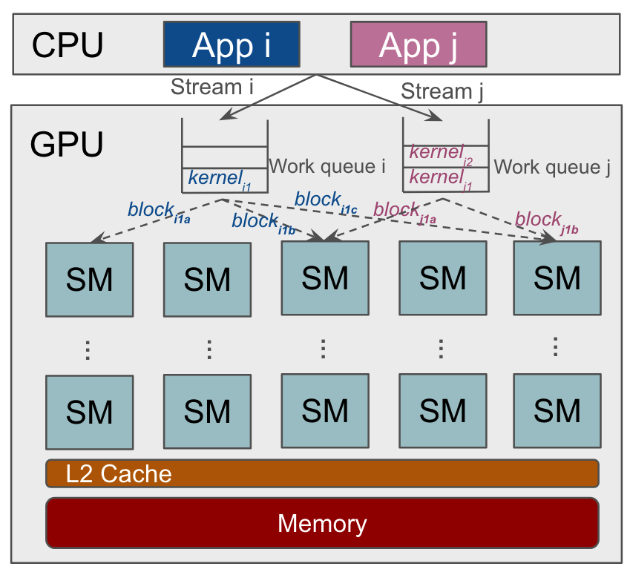


Background- GPU scheduling flow
DL workload#1
Conv
MaxP
Batch
Conv2D
Maxpool
BatchNorm
Conv
MaxP
Kernel
Block
MaxP
Compiled
DL workload#2
Conv
MaxP
Batch
Conv
Batch
Batch
[Eurosys’24] STRATI, F., MA, X., AND KLIMOVIC, A. Orion: Interference-aware, Fine-grained GPU Sharing for ML Applications, p. 1075–1092.
Notes:
By combining our knowlege in architecture and sharing, we could construct our scheduling flow f compiled functions are transformed in to kernels, and a kernel would comprise of multiple blocks, depending on cuda library

Slide 9
GPU sharing
workload #1
workload #2
Block
1
2
3
1
2
3
1
3
kernel
1
2
1
3
2
Time
3
SM
No sharing
1
2
3
1
2
3
GPU
1
3
1
2
Execute workload sequentially
Underutilization
1
3
2
Underutilized
3
Underutilized
Context switch
Fairness for multiple users
Context switch cost
No concurrency – GPU still underutilize
Temporal sharing
1
1
2
2
3
3
GPU
1
1
2
3
1
Underutilized
2
3
3
Interference
Most memory and compute efficient!
1
1
2
3
Higher utilization due to concurrent block execution
Interference from non-isolated resource.
GPU
1
2
3
3
Spatial sharing
1
2
3
1
2
3
Time
Notes:
Assuming ppl have background in GPU architecture. May cut if Lets look at some common gpu sharing mechanisms. Lets use two workloads arriving at the same time as example, which are shown at the top with different kernel and blocks. First, lets look at the case without any sharing. The workloads are executed sequentially, executing workload1 then 2. Obviously, each workload does not fully use the gpu. Next temporal sharing. Temporal sharing fairly schedules kernels different process within time interval. f However, it does incur context switch cost without actual concureency, thus does not fully utilize gpu within a context window. The best approach is spatial sharing, which acutally executes kernel concrrueently, thus fully uitlizae the compute resource. To increase utilization, we try to predict coloation under spatial sharing context swtich cost – 25-50us

Slide 10
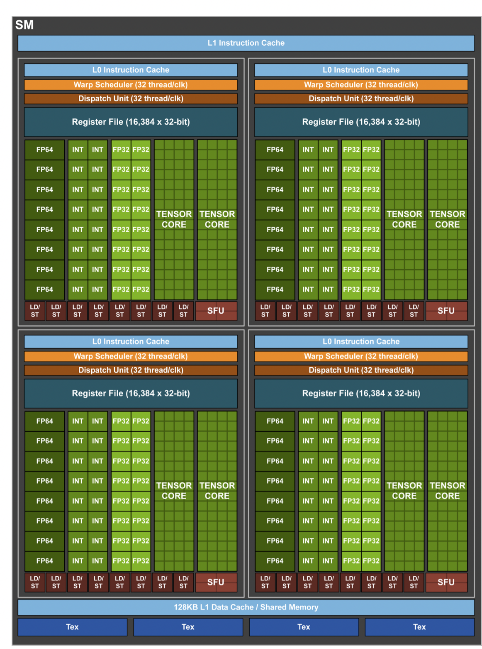
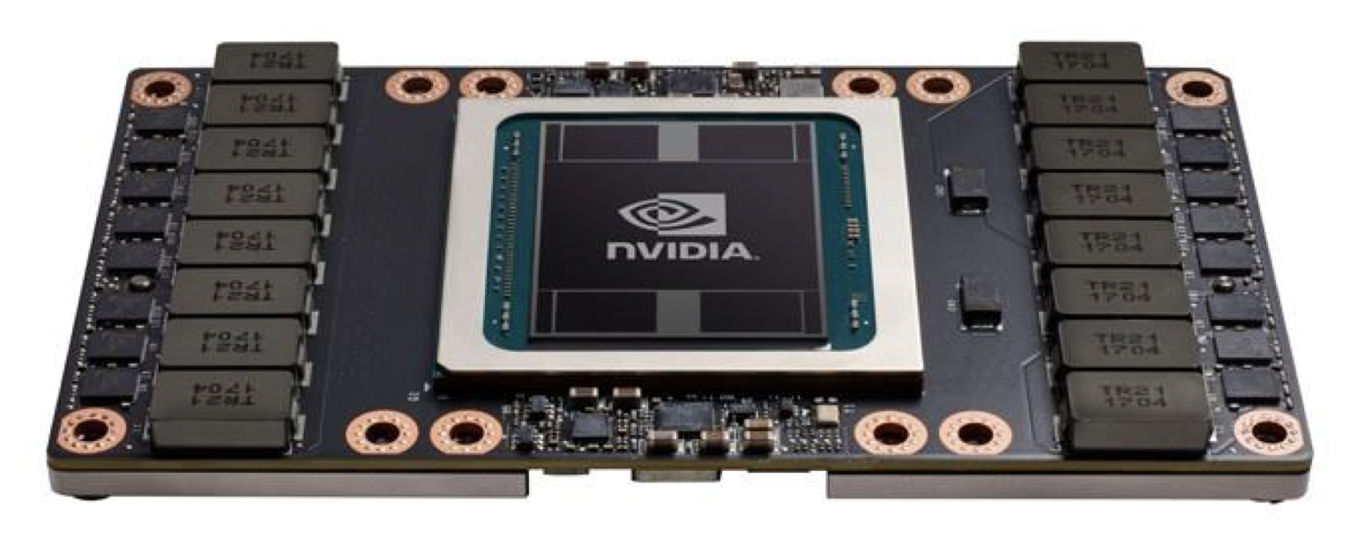
Background- GPU Performance metrics
Conv
MaxP
Batch
Overall GPU system metrics
Easy and fast to obtain
Quick system view, not kernel specific
GPU utilization (SM busy rate)
Memory busy rate
Memory footprints
Kernel metrics
Fine-grained profile of each GPU unit
Long profile time, requires profile tool
Stream Multiprocessor (SM) Throughput
Max Memory throughput across units
Registers
Shared memory usage
NVIDIA Volta Architecture Whitepaper, https://images.nvidia.com/content/volta-architecture/pdf/volta-architecture-whitepaper.pdf
Notes:
We use both metrics to give a good estimation of resource requirememnt
GPU metrics - SM busy rate. This metric represents the percentage of time over the past sample period during which one or more kernels were executed on the GPU, often referred to as GPU utilization.
Mem busy rate - This metric indicates the percentage of time over the past sample period during which device memory was being read or written, often referred to as GPU memory utilization.
Shared Memory - Shared GPU memory is a type of virtual RAM reserved from the actual RAM of the computer itself. Shared memory is a partition of RAM that connects to the GPU using PCIe connectors, thus the speed is slower than GPU device memory

Slide 11
Related work
 | Profile type | GPU Share type | Profiled metrics | Train/ inference | Prediction | Difference vs our work
MISO, SOCC’22 | Online | Spatial | Completion Time | Train | V | Excessive online profiling, HW support, train only
Xu et al, Hotcloud’19 | Offline | Temporal | Kernel | Both | V | Temporal prediction
Horus, PDS’22 | Offline | Temporal | DL graph | Train | V | Temporal, need DL semantics, train only
Orion, Eurosys’24 | Offline | Spatial | Kernel | Both | X | No performance prediction
KACE | Offline | Spatial | Kernel | Both | V | Spatial prediction, offline, train+inf
Our work focuses on accurate colocation predictions under spatial-sharing with offline kernel profiling
Notes:
Summary related work Here are some of the related works regarding colocation prediction. We classify these works by the way to profile, GPU share type, profile metrics, and target DL application. First, miso provides online profiling on gpu spatial sharings. However, the online profiling requires excessive dry runs, and it needs better GPU support for more advanced spatial sharing mechanism. Xu et al uses offline profiled kernel metrics to predict temporal sharing interferences. Its predictions are targeting temporal sharing, which is not accuratet for spatial-shares. Horus predicts temporal shairng with offline profiled DL computation graphs. The solution is not applicable on inference workloads due to its non periodic resource patterns, and it requires DL semantics as profile Our work tries to accurately predict colocations offline with kernel metrics under spatial sharing for both training and inference Our work do not require excessive online profiles, while integrated with more efficient spatial sharings, further mor, it is workload-agnostic, meaning we do not extract DL specific features for more related works, please check on report for more. Horus: DL computation graph metrics (e.g., MaxPool, Conv, Relu counts), estimate utilizion
Bubbleup - ServerMore: CPU, memory
Bubble-up – sensitivity modeling , web application LightGBM - an ensemble learning framework, specifically a gradient boosting method, which constructs a strong learner by sequentially adding weak learners in a gradient descent

Slide 12


System design
How to use individual workload’s offline profile to predict online colocated performance?
Reduce search space: profile O(n) individual workloads ( , , ) instead of O(n^2) pairs (. , , …)
Training set
Feature set
System metrics
SM_busy
MEM_busy
MEMCAP
Workload_xput
Split training set
Profile individual workload
Profile datastore
Generate pair features
Workloads
Kernel metrics
SM_xput
MEM_xput
DRAM_xput
#Threads
#Registers
sharedmem
Trainer
Offline Phase
Workload profiler
Workload profiler
Workload profiler
Online Phase
Deploy model
Profile once
Testing pairs
(Target,Candidate,Xput sum)
( , , 0.8 )
( , , 0.5 )
( , , 0.3 )
Target workload
Predictor
Query profile
GPU
Candidate workload pool
Notes:
….
We are only doing individual profile – O(n) - )(n)
Key component is workload profiler, which can be found in paper
|Now lets jump to evaluation

Slide 13
Evaluation - methodology
Setup
Single node server in Chameleon Cloud. Hardware - 2 Intel Xeon Gold 6230 CPUs, 128GB RAM, and a 32GB NVIDIA V100 GPU. Software - PyTorch 1.13, CUDA12.3
Prediction Models
Linear Regression, Random Forest, Neural Network, AutoML
Workload | Batch | Application | SM busy (%) | Mem busy (%) | Memcap (GB)
BERT-train | 2,8,16 | Recommendation | 97.0 | 45.2 | 5.1
ViT-train | O | Image classification | 97.2 | 37 | 17.6
ALBERT-train | O | Recommendation | 97.2 | 45.1 | 7.1
BERT-inf | X | Recommendation | 95.1 | 38.6 | 1.4
ViT-inf | X | Image classification | 28.5 | 5.4 | 3.2
Whisper-inf | O | Speech recognition | 44.2 | 19.6 | 11.7
Wav2vec2-inf |  | Speech recognition | 18.9 | 6.6 | 12.2
Notes:
We use various regression models for predictions
Don’t discuss the table, just say “we use a variety of inference and training workloads with different batch sizes, as shown here”. Don’t waste time on the table and explaining it.
automl automiatically tries through a set of regression and NN models within a time quantum(60s) we use a variety of inference and training workloads with different batch sizes, as shown here By considering all possible pairs of workloads that can be accommodated in GPU memory, we obtain 181 possible colocations
workloads 21 in total, 7 training and inference models with 3 batch sizes each
Average SM busy rate over 60%

Slide 14
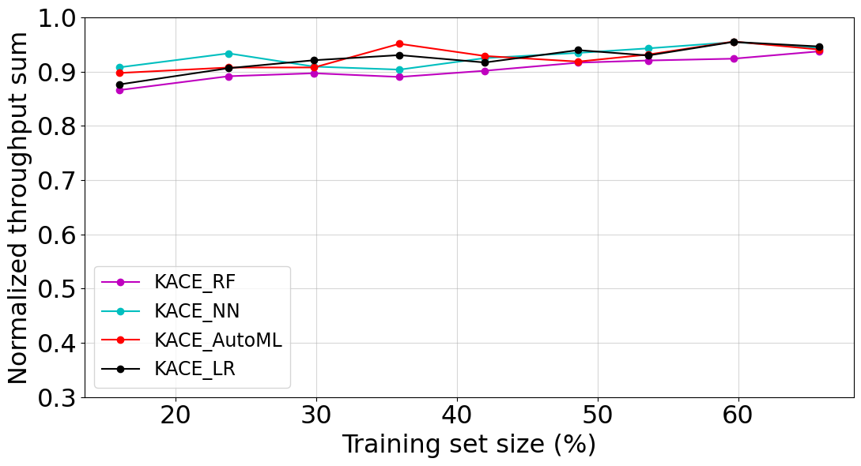
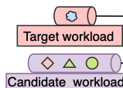
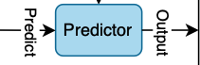
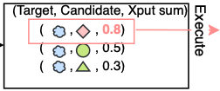
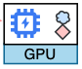
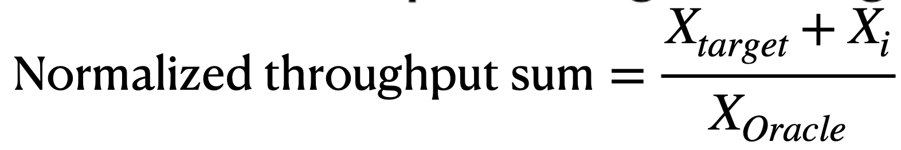

Evaluation - Workload colocation with tested ML models
Demonstrate how actual throughput is impacted with the predicted pair being executed
Compared throughput sum with Oracle. Averaged with all 21 workloads as target.
LR achieves similar throughput sum compared with other ML technique
We use LR for its accuracy and fast training time
Notes:
Add impractical under oracle
Oracle is offline optimal, impractical
This evaluation demonstrate how the actual throughput is impacted with the predicted pair being executed We define the evaluation metric as normalized throughput sum, which calulates the executed throughput sum of target and predicted candidate,. divided by oracle. Oracle is the workload pair with highest throughput sum for a given target. The results are averagd with 21 workloads as targets As we can see all models achieve good throughputs, proving that KACE achieves strong performance across various models by combining the results of previous slides , we choose LR as our prediction since it achieves fastest training time with good accuracy X – throughput

Slide 15
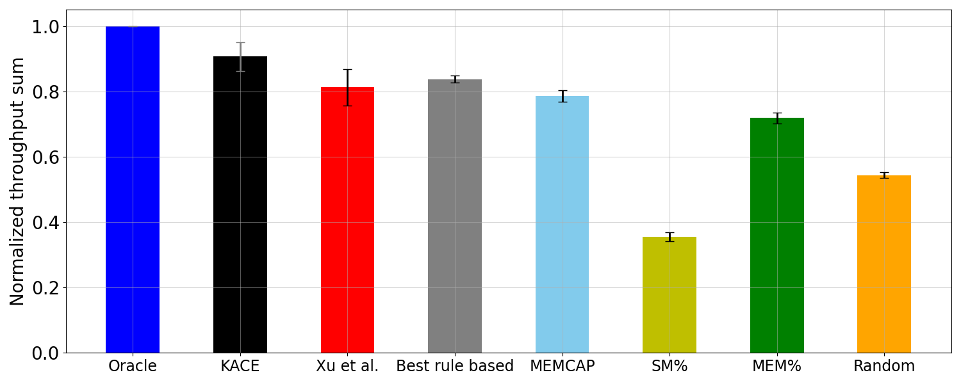
Evaluation - Workload colocation vs baseline policies
90.6%
81.3%
83.7%
78.5%
71.8%
54.3%
35.4%
Random performs poorly
Rule-based approaches do not encapsulate kernel information
Xu et al. targets temporal sharing
KACE achieves 90% throughput sum compared with Oracle
Notes:
Kernel metrics collected are not perfectly fitting the spatital-sharing

Slide 16
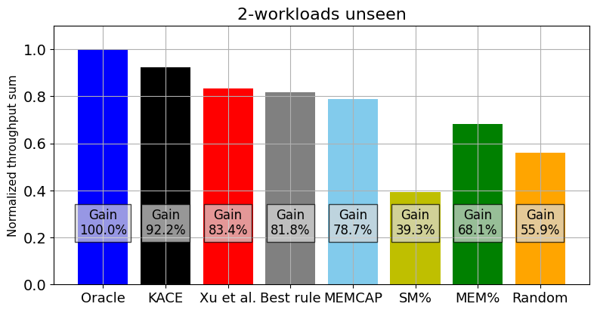
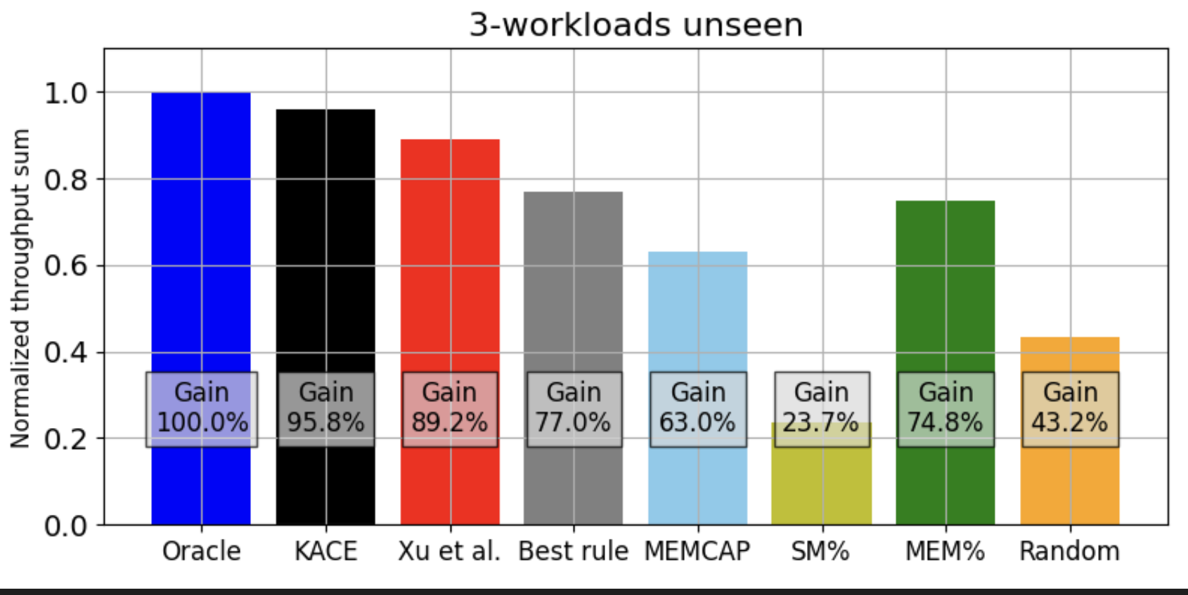
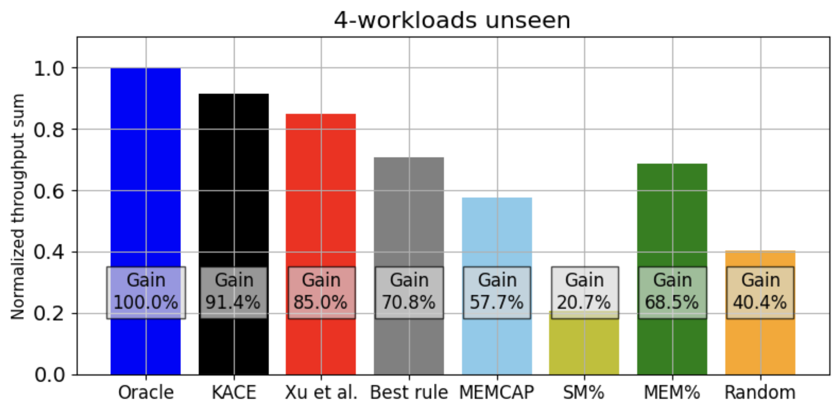
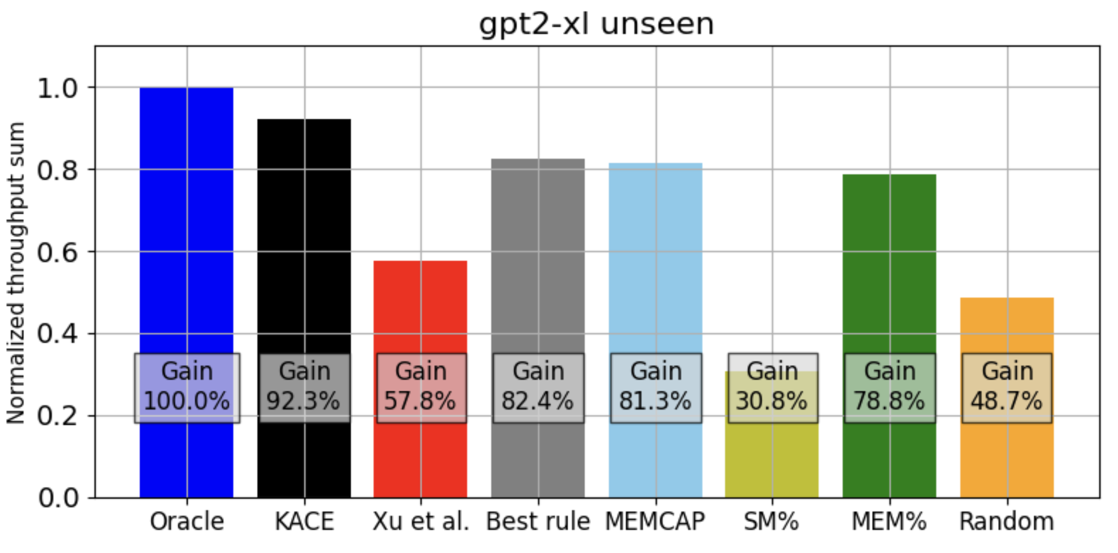
Evaluation- unseen and autoregressive workloads
Unseen workload
Achieves 92% / 96% / 91% of Oracle sum
Achieves 92% of Oracle sum
10% better than next-best policy
Autoregressive workload (unseen)
More analysis in paper!
Notes:
Unseen – target workload not seen in training set
Autoregressice

Slide 17


Summary
KACE is a ML system framework that accurately predicts GPU spatial-sharing interference, achieving over 90% of Oracle’s throughput sum.
Selects key kernel & system metrics for lightweight performance prediction
Limited offline profiling of individual workloads
Simple LR model for accurate colocation prediction with minimal training time and small dataset
Questions?

Slide 18
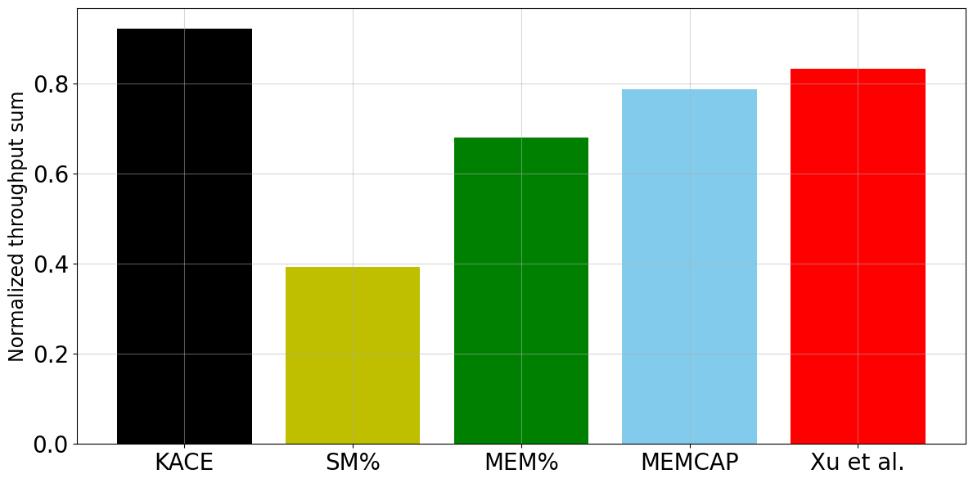
Evaluation - Colocation with unseen workloads
16%
11%
An important evaluation since new workload can be encountered at runtime or the training set size is limited
With given target unseen in training set for all batch sizes, predict max throughput sum when colocating target with 1 candidate workload
KACE outperformed the next-best approach by 11%
KACE can be transformed into a fully-online scheduler
Notes:
Batch 16 of each workload type (7 train and inferendce types) are tested with average why reason ber? Evaluate wor prepare 2,8,16 graphs if being asked KACE achieves an 11% higher and a 16% higher average throughput sum, respectively over 90%

Slide 19
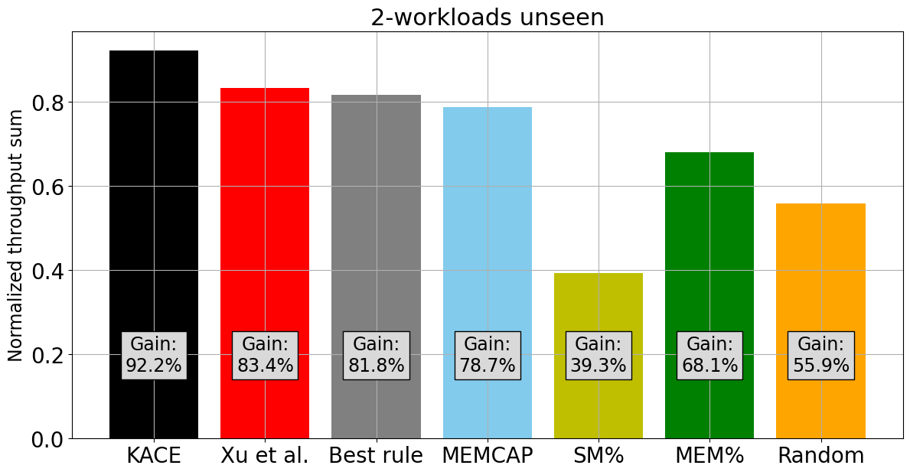
Evaluation – Multiple unseen workloads
16%
1%
KACE achieves 96% and 91% throughput sum achieved by Oracle for colocating >2 workloads

Slide 20
Evaluation- Autoregressive workloads
Average of 3 output token length
Profiled prefill and decoding stage of the first token
Saved 1.5hr profile time
Decoding is memory-intensive – use MEMCAP to capture memory footprint of varying output token length
KACE achieves 92% throughput sum achieved by Oracle, 10% better than next-best policy

Slide 21
System vs Kernel metrics
Conv
MaxP
Batch
 | System metrics | Kernel metrics
Granularity | Coarse-grained, entire GPU | Fine-grained, per kernel
Performance accuracy
Profile time
Can we profile individual workload offline instead of all online combinations?

Slide 22

Evaluation
How accurate is KACE’s throughput prediction?
With KACE’s predicted workload pair, how well are the actual colocated throughput?
If a workload is not seen in training set, can KACE still predict the best workload to colocate with?
Can KACE be used in more than 2 workload pairs?
Can autoregressive workloads work with KACE?

Slide 23

System design- Profiler
How to generate individual workload profile?
Aggregate features of two workloads
sum – metrics with absolute value, e.g. Number of threads
average – metrics with %, e.g. SM busy rate
Nvidia-smi
System metrics
SM_busy
MEM_busy
MEMCAP
Workload_xput
Duration - 100 steps
Kernel functions | sgemm
SM_xput | 50
MEM_xput | 50
DRAM_xput | 30
#Threads | 500000
#Registers | 5000000
Sharedmem | 5000
elementwise
80
80
20
800000
3000000
2000
Softmax
20
10
50
200000
1000000
2000
Aggregated
50
50
33
1500000
9000000
90000
Combine metrics
Workload profiler
Duration - 1 forward + backward pass (train), 1 forward pass (inference)

Slide 24
System design- Profiler
How to generate individual workload profile and paired feature set?
Feature set
Nvidia-smi
System metrics
SM_busy
MEM_busy
MEMCAP
Workload_xput
System metrics
SM_busy + SM_busy
MEM_busy。+ MEM_busy
MEMCAP 。 + MEMCAP
Workload_xput 。 + Workload_xput
Duration - 100 steps
Workload profiler
Combine metrics
Kernel metrics
SM_xput + SM_xput
MEM_xput + MEM_xput
DRAM_xput + DRAM_xput
#Threads + #Threads
#Registers + #Registers
Sharedmem + Sharedmem
Kernel metrics
SM_xput
MEM_xput
DRAM_xput
#Threads
#Registers
sharedmem
Duration - 1 forward + backward pass (train), 1 forward pass (inference)

Slide 25
System design of KACE
Offline training
Profile workload features
Model training
Online predictions
Combine target and candidate features
Predicts workload pairs with highest throughput sum
Notes:
Try to keep the position of the figure exactly the same. Will make transitions smoother. Second part is to predict the workload pair with highest throughput sum within in incoming target workload

Slide 26
System design - Profiler
Profile individual workloads.
GPU system metrics (nvidia-smi)
Quick overview, not kernel-specific
Utilization (SM busy rate)
Memory busy rate
Memory capacity
Kernel metrics (Nsight Compute)
Fine-grained profile, requires profile tool
Memory throughput
Dram throughput
Num of Threads
Num of Registers
Shared memory
Individual workload throughput
Notes:
We profile all individual workload as opposed to profiling all possible workload pairs which could be time-consuming. GPU metrics - SM busy rate. This metric represents the percentage of time over the past sample period during which one or more kernels were executed on the GPU, often referred to as GPU utilization.
Mem busy rate - This metric indicates the percentage of time over the past sample period during which device memory was being read or written, often referred to as GPU memory utilization.
Shared Memory – shared memory on chip has higher bandwidth and lower latency. Shared through blocks Shared GPU memory is a type of virtual RAM reserved from the actual RAM of the computer itself. Shared memory is a partition of RAM that connects to the GPU using PCIe connectors, thus the speed is slower than GPU device memory
we get the aggregate sum based on the kernel metrics we also get individual throughput along with profile runs since it is a good indicater of shared throughput without additional overheads Profile time - System metrics short run on average, ∼1 minute, 100 steps for each workload kernel metrics - (5-10 mins)
Shared memory 0

Slide 27
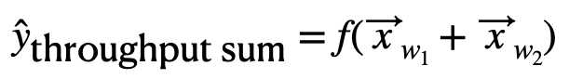
System design – Trainer
Train regression model to predict the colocated throughput sum
Aggregate features of two workloads
sum – metrics with absolute value, e.g. Number of threads
average – metrics with %, e.g. SM busy rate
Notes:
Do we add up all features? Or only some? Like % features are weighted, no? Ans - % are average of two the model’s input

Slide 28
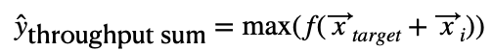
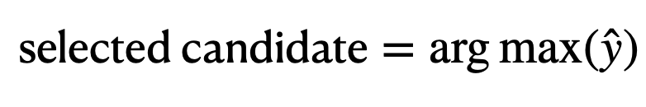
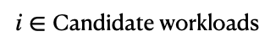
System design – Predictor
Extract from test set with all target workload combinations
Use trained model to predict the colocated pair with maximum throughput sum
Execute predicted pair on GPU
Notes:
For each target workload, we build our testing set by finding the colocation pairs including target workload, and all other candidate workloads

Slide 29
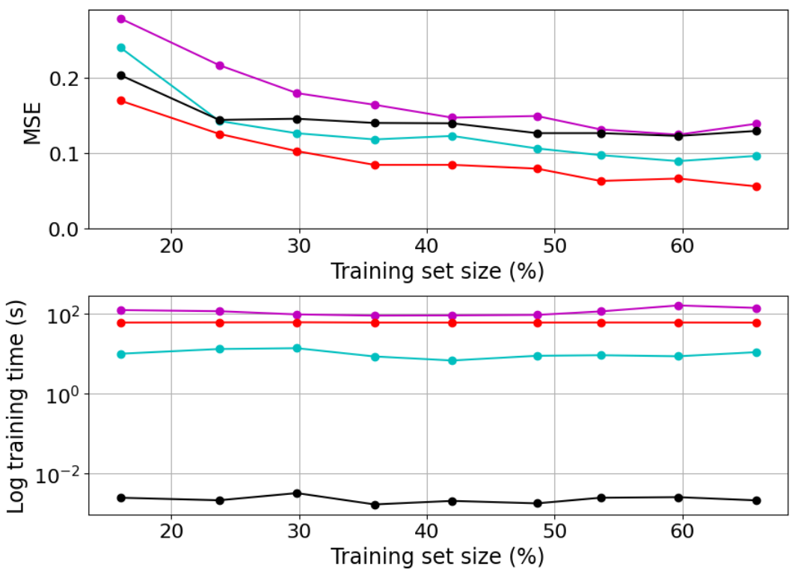
Evaluation - Workload colocation with tested ML models
10s
60s
RF requires grid search for better performance
AutoML analyze a set of regression and NN models within time budget
NN updates model parameters with back propagation
LR requires least training time without parameter searches
We select Linear Regression for its accuracy and fast training time
Notes:
Parameter searches – RF, grid search, AUTOML search all models why training time matter offline? We find LR is quick to train Remove page 32? Hard to justify selection of LR combining the colcoation results in previous slides we select LR for its accuracy and fast training time Training time does not increase with training set since total set size is still small < 200 RF – 120 seconds
AUtoML – budget is 60 sec LR is the black line

Slide 30
Evaluation - baseline policies
Baseline policies for workload colocations
Oracle – Impractical, optimal policy that selects workload pair with highest throughput sum
Xu et al – Predicts colocation under temporal-sharing with kernel metrics
Rule-based approaches with system metrics
MEMCAP – choose colocated workload with smallest GPU memory footprint
SM% – choose colocated workload with highest SM busy rate
MEM% – choose colocated workload with lowest GPU memory busy rate
Best rule based – best value of MEMCAP, SM%, MEM%
Random – mean of throughput sums of all possible colocations

Slide 31
GPU scheduling
 | GPU Share type | Schedule granularity | Train /Inference | Control knob
Antman, OSDI’20 | Temporal | Iteration | Train | Memory states
Gandiva, OSDI’18 | Temporal | Iteration | Train | Memory states
TGS, NSDI’23 | Temporal | Kernel | Train | Kernel ingestion
Gavel, OSDI’20 | Temporal | Workload | Both | Schedule policy, heterogenous HW
Reef, OSDI’22 | Spatial | Kernel | Inference | Kernel preemption
Salus, MLSys’24 | Spatial | Iteration | Train | Memory state
Orion, Eurosys’24 | Spatial | Kernel | Both | Kernel types
KACE | Spatial | Workload | Both | Workload profile, system throughput
Notes:
Next, we move on to prior works regarding GPU scheduling. We classify the works based on GPU share type, scheuedlle granularity, granularity as workload, iteration, and kernel levels, from coarse grain to fine-grain, traing or inference workload, and control knob. We will only expand on spatial sharing in this talk. Please refer to the rpe report for more details regarding other related works Next, we move on to prior works regarding GPU scheduling . These works are often achieved with large Gpu clusters. We classify the scheuedling type with temporal and spatial sharings. Also, We categorize schedule granularity as workload, iteration, and kernel levels, from coarse grain to fine-grain. More fine-grained scheduling often requires better hardware support. Workload level takes secs to mins to finsh, and iteration takes 10ms to secs. Kernel level takes us-ms. The first two work increasesv GPU utilization by moving temporary outputs between host and memory. temporal sharing are more flexible to memory designs since it do not come with memory space partitions. TGS changes kernel ingestion rate to prioritize primary workload. However,It onlt evaluates training and GPU may incur frequent GPU page faults when switching between kernels. Gavel focuses on enabling multiple scheduling policies thorugput heterogenous HW, which is orthogonal to our single GPU sharing setups. We will but IN our RPE, we want to enable spatial sharing on workload level while being workload-agnostic. We will talk about more foucs
Training-specific solution often include iteration-level designs
Due to the relations, we only expand on details of spatial sharings
We have Defined Schedule units by level - from coarse to fine-grained

Slide 32
Prior work – GPU scheduling with spatial sharing
Reef
Improves DL inference serving by enabling kernel-level preemptions on the GPU based on the idempotency of inference matrix multiplication
Only support AMD GPUs due to runtime and Apache TVM compiler open-source support
Salus
Saves memory space at the iteration-level for training tasks by quickly releasing intermediate outputs while persisting model parameters.
Not applicable to inference due to training’s iteration periodic pattern.
Orion
Colocates memory and compute-intensive kernels to reduce interference.
Maintain two-level GPU streams to prioritize latency-sensitive workloads.
Requires advanced CUDA support for kernel-level scheduling with customed streams.
Fine-grained spatial sharing requires hardware support
Notes:
Reef –improve latency by preempting kernels. However, this requires AMD and opensource compiler cuppsorts inference prememption
salus – lack of periodic patterns in training. real Orion - classifies kernels as memory or compute intensive to reduce interference. However, it requires CUDA support on kernel scheduling by setting priority streams
Fine-grained spatial sharing require hardware support especially without the is why we enable workload-level scheduling application semantics. which

Slide 33
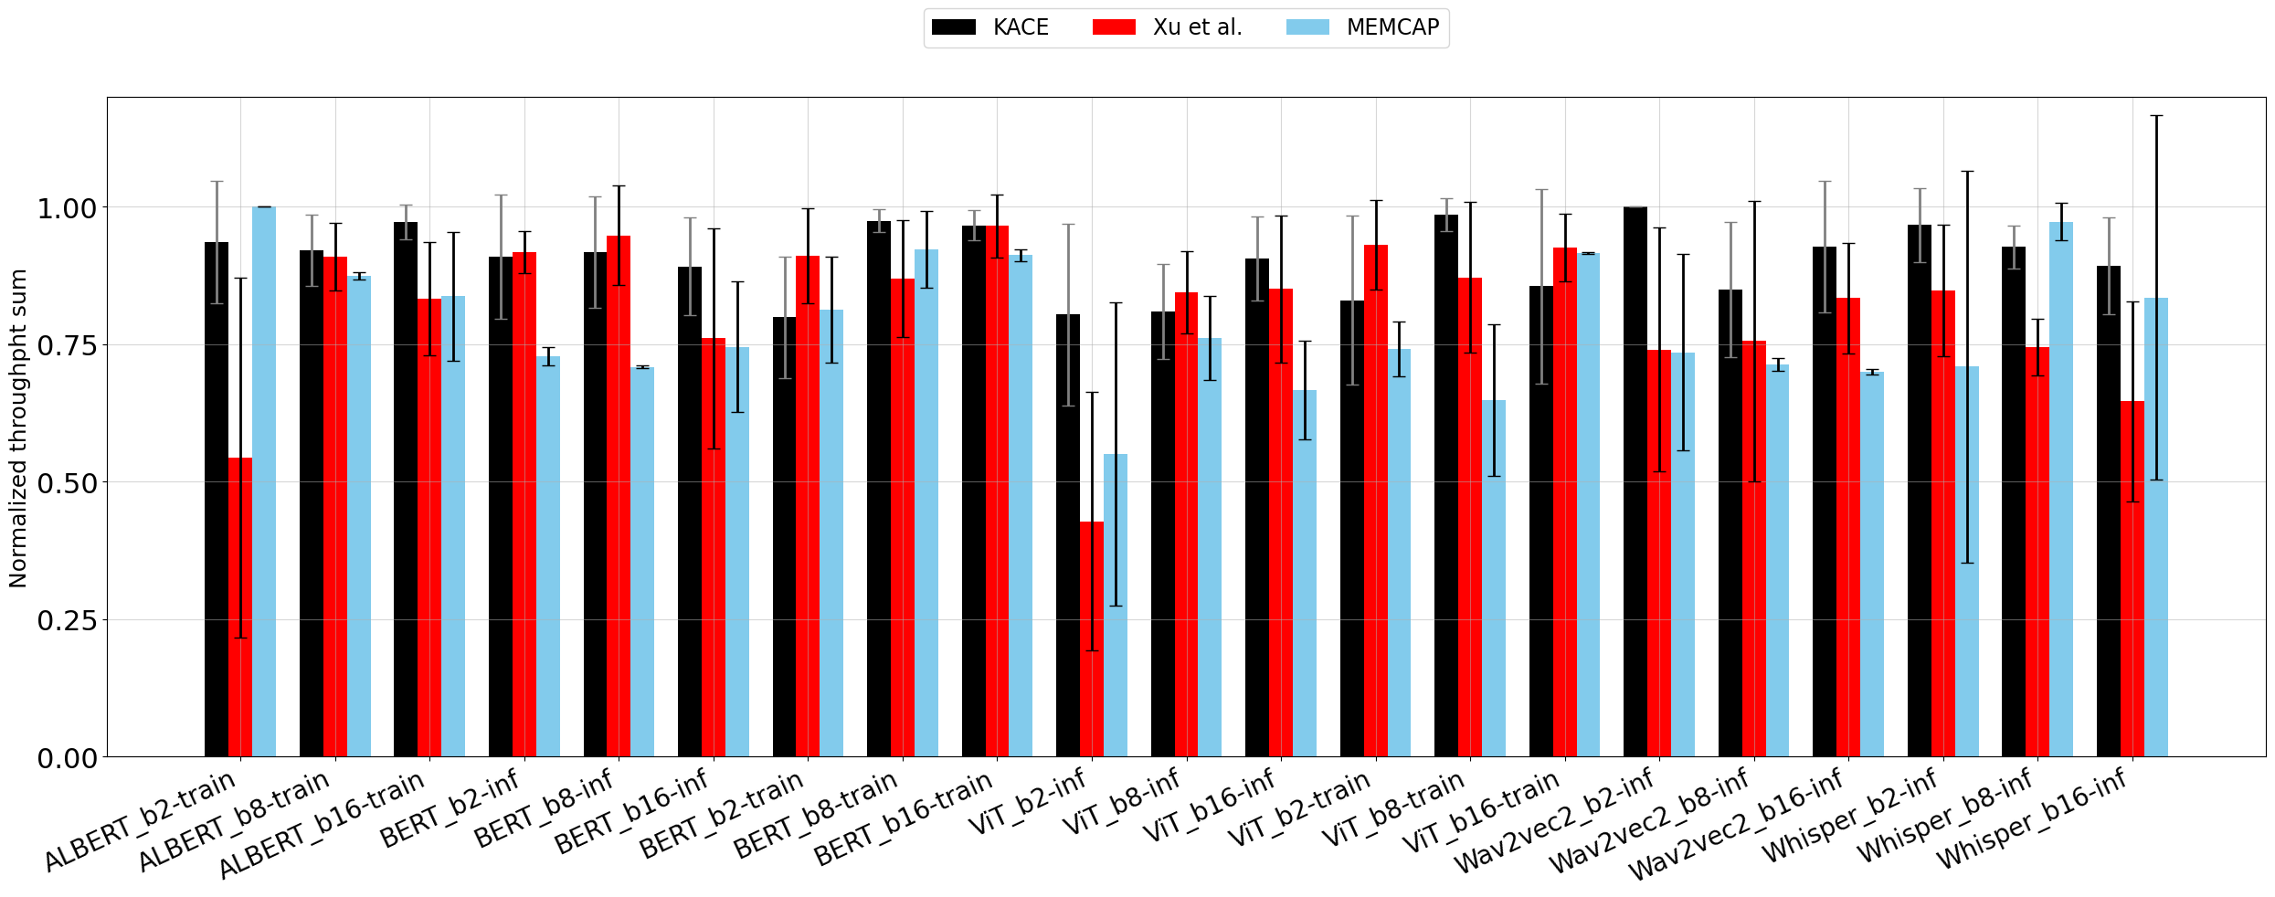
Evaluation - Colocation with different target workload
KACE is the best policy in 13 cases out of 21 test sets
Xu et al. ignores batch effect to throughput, causing weaker performance
MEMCAP selects BERT-batch2-train with minimum footprint, which is compute heavy (92 SM%)
KACE is more consistent than other baselines
Notes:
Skip this slide since performance is not that good? You can keep this, it is ok. RPE is not about how good the results are. Don’t say weaker perf, say poorer performance of just “resulting in poor performance” let us focus on one individual workload as example
Xu et al does not select the best pair since it selects a batch 2 workload to collocate with, which can impact the performance more in small throughput case , like vit-b2-inf In Vitb2-inf case, Xu et al. consistently selects another ViT_b2-inf as the colocation candidate due to its low SM and MEM usage, underestimating the throughput benefits of larger batch sizes, and thus fails to choose the optimal ViT_inf-b16 colocation candida

Slide 34
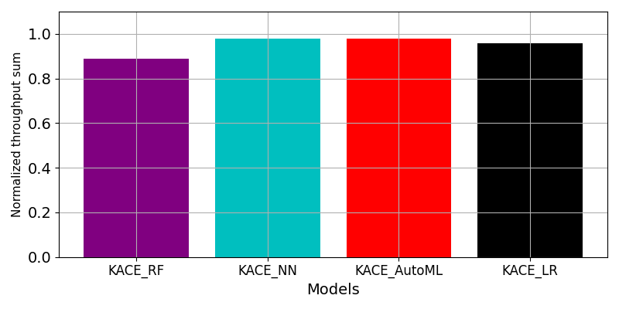
Future work - unseen multi-workloads prediction
89.0%
97.9%
97.8%
95.8%
With given target unseen in training set, predict max throughput sum when colocating target with 2 additional workloads
Better predicted results since more high-throughput candidates are presented
Consider other colocation strategies
Latency-sensitive + best-effort tasks
Evaluate latency and completion times
KACE can predict multiple-workload colocations
Notes:
Why accuracy better than previous slides? (we have included all other workloads as training set each time, so training set is huge (560 – 30 as target, 530) Again, explain what you did here. From a set of workloads, are you saying this is the xput if KACE picks 3? Or given 1 fixed workload, KACE picks 2 more?
These are preliminary numbers that we are still exploring metrics why throughput metrics Throughput may not be sufficient enough to evalute multiple workload

Slide 35
Q & A

Slide 36
Appendix

Slide 37
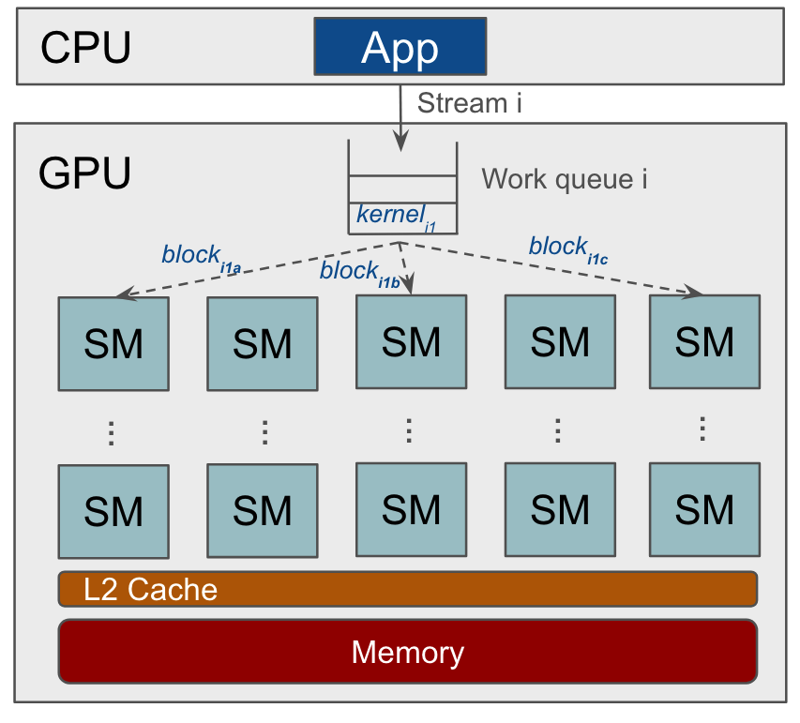
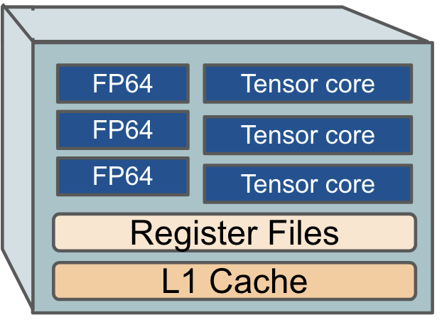
GPU architecture
FP unit
Unit to process floating point
Tensor core
Specialized core that enabled mixed precision training
Register
fastest on-chip memories that are used to store operands for the operations
Notes:
Registers are fast on-chip memories that are used to store operands for the operations executed by the computing cores.

Slide 38
GPU Performance monitoring
Overall GPU metrics
Easy and fast to obtain
Quick system view, not kernel specific
GPU utilization (SM busy rate)
Memory busy rate
Memory footprints
Kernel metrics
Fine-grained profile within SM
Long profile time, requires profile tool
Stream Multiprocessor (SM) Throughput
Max Memory throughput across units
Registers
Shared memory usage
Notes:
Move this to system design GPU metrics - SM busy rate. This metric represents the percentage of time over the past sample period during which one or more kernels were executed on the GPU, often referred to as GPU utilization.
Mem busy rate - This metric indicates the percentage of time over the past sample period during which device memory was being read or written, often referred to as GPU memory utilization.
Shared Memory - Shared GPU memory is a type of virtual RAM reserved from the actual RAM of the computer itself. Shared memory is a partition of RAM that connects to the GPU using PCIe connectors, thus the speed is slower than GPU device memory

Slide 39
Colocation prediction – non-GPU
Scavenger
Bubble Up
Forecasts interference in data center memory systems by calculating memory pressure scores with pre-measured memory pressure curves
SmartHarvest
Colocates primary customer VMs with batched job VM.
Predicts the peak CPU core usage of primary VMs for each time window to decide core allocation using classification models.
Results are not publicly available. Challenging to replicate since historical trace and implementation details are not publicly available.
Our work focuses on predicting GPU workloads
Notes:
Could go away

Slide 40
Prior work – GPU scheduling with temporal sharing
Antman
Shares DL training workloads by swapping cached memory of temporary outputs to host memory at each iteration.
Controls kernel launch frequency of opportunistic jobs to ensure SLA of primary workload
Gandiva
Introduces iteration level checkpoint-restart mechanism to transfer training states between GPU and host memory
training-specific scheduling are easier to adapt with temporal sharing
Notes:
Antman - shares more workloads by swapping cached memory of temporary outputs (data preprocessing, intermediate layer outputs) to host memory at each iteration. Both antman and gandiva are training specific since they leverage training periodic pattern to reduce memory bursts Scheduling workload-level iteration level WE could see that temporal sharing is easier to adopt for temporal-sharings since it is inherently flexible as the entirety of GPU CUDA and memory resources are being transferred from one process to the next Overall , temporal sharing allow modification on traning-specific secheduling iper iteration without strong hardware support. Scheudling on workload kernel levels have their challenges temp outputs (data preprocessing, intermediate layer outputs)

Slide 41
Prior work – GPU scheduling with temporal sharing
TGS
adopts a kernel-level adaptive rate control mechanism to manage incoming kernels for containerized workloads
Overheads of GPU page faults can be significant when swapping kernels
Gavel
Generalizes workload-level scheduling policies with heterogeneous hardware by expressing them as optimization problems
Cannot dynamic scale due to fixed hardware count and batch size
Workload-level scheduling avoids memory overheads

Slide 42
Prior work – GPU scheduling without sharing
Allox
Schedules DL job on CPU and GPU.
Transforms DL job scheduling into a min-cost bipartite matching problem.
Not suitable for large DL models.
Tiresias
Prioritizes workloads with the highest complete probability in the next service quantum.
Do not consider resource scaling, and requires profiling on duration of all test workloads
Pollux
Trades off training efficiency during low cluster resource pressure to increase overall system throughput by dynamically scaling batch size and GPU count.
Not applicable for heterogenous GPUs.
Targets large DL models that do not fit in one GPU
Notes:
Dynamic resource allocation and heterrohemous setups pollux trades of training efficiency and system throughput depends on how much resource are used within a custer

Slide 43
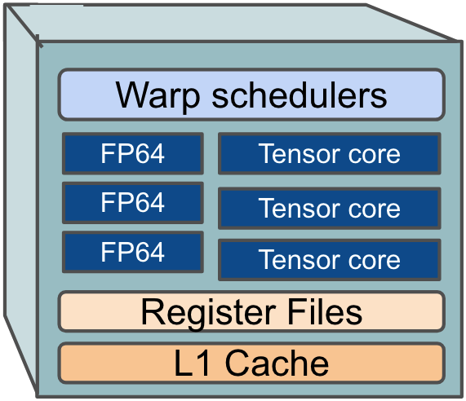
GPU architecture
Warp Schedulers
warp – 32 threads in a block that executes same instruction
Schedule warp execution. New block is launched in SM until all warps have sufficient registers
FP unit
Unit to process floating point
Tensor core
Specialized core that enabled mixed precision training
Register
fastest on-chip memories that are used to store operands for the operations
Notes:
Registers are fast on-chip memories that are used to store operands for the operations executed by the computing cores.

Slide 44
GPU sharing
workload1
workload2
workload3
Context switch
Context switch
Compute Isolation (Nvidia MPS)
SM
Unused
Cache/Mem
Compute+Memory Isolation (Nvidia MIG)
NO sharing
One workload at a time
Resource not fully utilized
Temporal sharing
Switch workload within time window
Context switch cost
Resource still underutilized
Spatial sharings
Higher util with partitioned SM/cache
Require advanced HW
Notes:
New slide on MPS and MIG compute memory isolation X axis as time added Without sharing – under utilized
Mention MPS GPU memory and compute - simple graph for illustration context switch
temporal sharing - not concurrency but it is fairly shared CPU – 5 us
GPU – 25-50 us
25-50 micro second

Slide 45
Future work – long term
Interference predictions with DL parallelism
LLM applications often require multiple GPUs
How and when should we share fragmented DL models on a GPU?
Introducing network interference, aside from compute and memory
Schedule policy for general data-intensive applications
Add GPU workloads apart from DL. E.g. protein simulations, graphic rendering, and data manipulation .
Naïve solution – separate compute, memory and IO intensive kernels
KACE is not DL-specific. The kernel profiling method can be adopted to heterogeneous workloads.
Notes:
Skip this slide

Slide 46
Evaluation - prediction accuracy
Evaluate accuracy for predicting throughput sum of each pair with increasing training set size
All four models achieve good accuracy, even for small training set
LR requires least training time without parameter searches
accurate
60s
10s
We select Linear Regression for its accuracy and fast training time
Notes:
Parameter searches – RF, grid search, AUTOML search all models why training time matter offline? We find LR is quick to train Remove page 32? Hard to justify selection of LR Training time does not increase with training set since total set size is still small < 200
RF – 120 seconds LR is the black line

Slide 47
How to use individual workload’s offline profile to predict online colocated performance?
Kernel functions | SM_xput | MEM_xput | DRAM_xput | #Threads | #Registers | Sharedmem
volta_sgemm | 50 | 50 | 30 | 500000 | 5000000 | 5000
elementwise | 80 | 80 | 20 | 800000 | 3000000 | 2000
Softmax | 20 | 10 | 50 | 200000 | 1000000 | 2000

Slide 48
Future work – dynamic thread allocations
MPS daemon
priorities
light computes
SM
40%
40%
20%
Targeted assignment
Share compute resource
Utilize dynamic thread allocation to control compute resources per-workload
Set workload Priorities
Share compute resource with light compute workloads
Notes:
In KACE, we already predict which workload to collocate with. Now we should enable * connect the kace with this. * connect the previous slides with this 100 1. throughput sum improve under certain case 2. more metric such as max-min fairness

Slide 49
Feature set
Training set
Profile
individual workload
System metrics
SM_busy
MEM_busy
MEMCAP
Workload_xput
Split training set
Profile datastore
Generate pair features
Workloads
Kernel metrics
SM_xput
MEM_xput
DRAM_xput
#Threads
#Registers
sharedmem
Trainer
Offline Phase
Workload profiler
Online Phase
Deploy model
Profile once
Testing pairs
Target workload
(Target,Candidate,Xput sum)
( , , 0.8 )
( , , 0.5 )
( , , 0.3 )
Query profile
Predictor
Candidate workload pool
GPU
Notes:
….
We are only doing individual profile – O(n) - )(n)
Key component is workload profiler, which can be found in paper
|Now lets jump to evaluation

Slide 50
System design- Profiler
How to generate individual workload profile and paired feature set?
Nvidia-smi
System metrics
Feature set
SM_busy
MEM_busy
MEMCAP
Workload_xput
System metrics
SM_busy + SM_busy
MEM_busy。+ MEM_busy
MEMCAP 。 + MEMCAP
Workload_xput 。 + Workload_xput
Duration - 100 steps
1 forward + backward pass (train), 1 forward pass (inference)
Workload profiler
Combine metrics
Kernel metrics
Kernel metrics
SM_xput
MEM_xput
DRAM_xput
#Threads
#Registers
sharedmem
SM_xput + SM_xput
MEM_xput + MEM_xput
DRAM_xput + DRAM_xput
#Threads + #Threads
#Registers + #Registers
Sharedmem + Sharedmem

Slide 51
GPU Utilization
Interference
100%
20%
80%
J2
J2
40%
J1
J1
NO sharing
Shared
Total completion time
100s
J2
Interference
70s
J2
40s
J1
J2
J1
J1
NO sharing
Shared

Slide 52
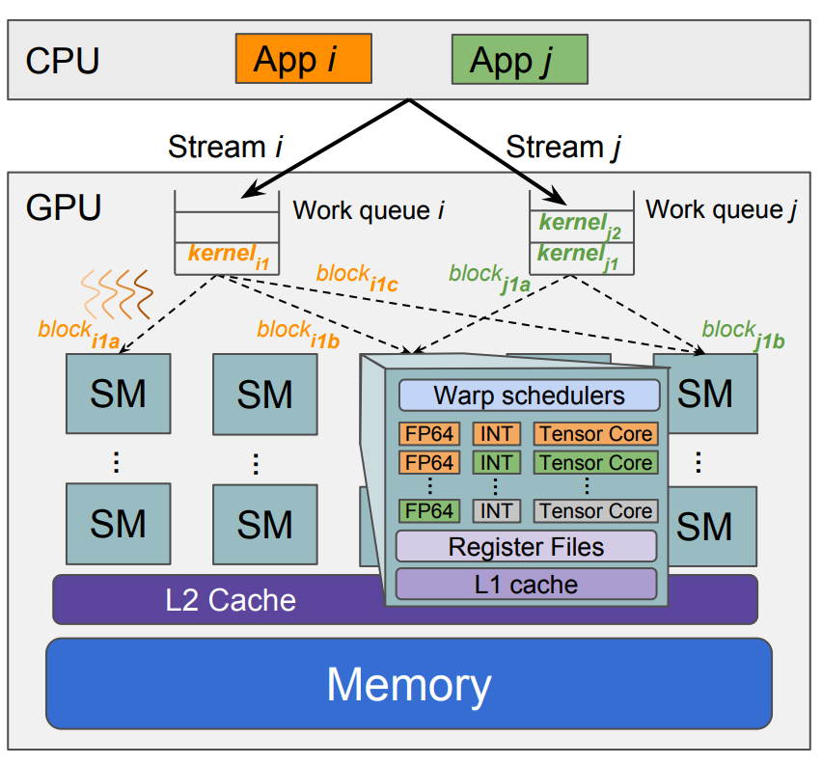
GPU architecture
Streams
A queue of GPU operations that are executed in a specific order
Kernel
A function meant to execute on GPU
Block
a group of threads that can be run in parallel
SM – Streaming Multiprocessor
Basic compute unit. “Core” in CPU
Warp Schedulers
warp – 32 threads in a block that executes same instruction
Schedule warp execution. New block is launched in SM until all warps have sufficient registers.
[Eurosys’24] STRATI, F., MA, X., AND KLIMOVIC, A. Orion: Interference-aware, Fine-grained GPU Sharing for ML Applications, p. 1075–1092.
Notes:
Just put one workload in here

